Slide 1

Patent system of the Republic of Kazakhstan. Patent application.
Prof. Darya Alontseva School of IT and IS D. Serikbayev East-Kazakhstan Technical University (EKTU), Ust-Kamenogorsk (Oskemen), dalontseva@ektu.kz, dalontseva@mail.ru

Slide 2

What is IP?
Intellectual property (IP) refers to creations of the mind – everything from works of art to inventions, computer programs to trademarks and other commercial signs.

Slide 3

Why does IP matter?
The progress and well-being of humanity depend on our capacity to come up with new ideas and creations. Technological progress requires the development and application of new inventions, while a vibrant culture will constantly seek new ways to express itself.

Slide 4
IP rights
Essentially, intellectual property rights such as copyright, patents and trademarks can be viewed like any other property right. They allow the creators or owners of IP to benefit from their work or from their investment in a creation by giving them control over how their property is used.

Slide 5
Different types and categories of IP
IP is often divided into two main categories:
Industrial property includes patents for inventions, industrial designs, trademarks and geographical indications.
Copyright and related rights cover literary, artistic and scientific works, including performances and broadcasts

Slide 6
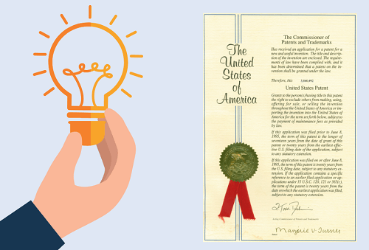
Patents
Patents were one of the first types of intellectual property to be recognized in modern legal systems. Today, patented inventions pervade every aspect of life, from electric lighting (patents held by Edison and Swan) to the iPhone (patents held by Apple).

Slide 7

Trademarks
A trademark is a sign capable of distinguishing the goods or services of one enterprise from those of other enterprises.

Slide 8
Copyright and related rights
Copyright, or authors’ right, is a legal term used to describe the rights that creators have in their literary, artistic and scientific works.
What works does copyright cover?
Copyright applies to the creative expression of ideas in many different forms – text, still or moving pictures, sound works, three-dimensional shapes such as sculptures and architecture, reference works and collections of data.

Slide 9
Industrial design
Industrial design rights cover those elements of a product that are aesthetic or ornamental – the way it looks and feels.
What designs can be protected?
Industrial design law only protects those aspects of a product that are ornamental; its technical features may be protected by patent, if they meet the requirements for patent protection. A design may consist of three-dimensional features, such as the shape or surface of an article, or twodimensional features such as patterns, lines or color.

Slide 10
International protection
As with other types of IP, international law has developed to complement and reinforce the protection offered in different national and regional jurisdictions. International recognition of appellations of origin and “indications of source” dates back to the Paris Convention of 1883. More recently, the agreement on Trade-Related Aspects of Intellectual Property (TRIPS) included some further provisions to prevent the misuse of GIs.

